Slide 1


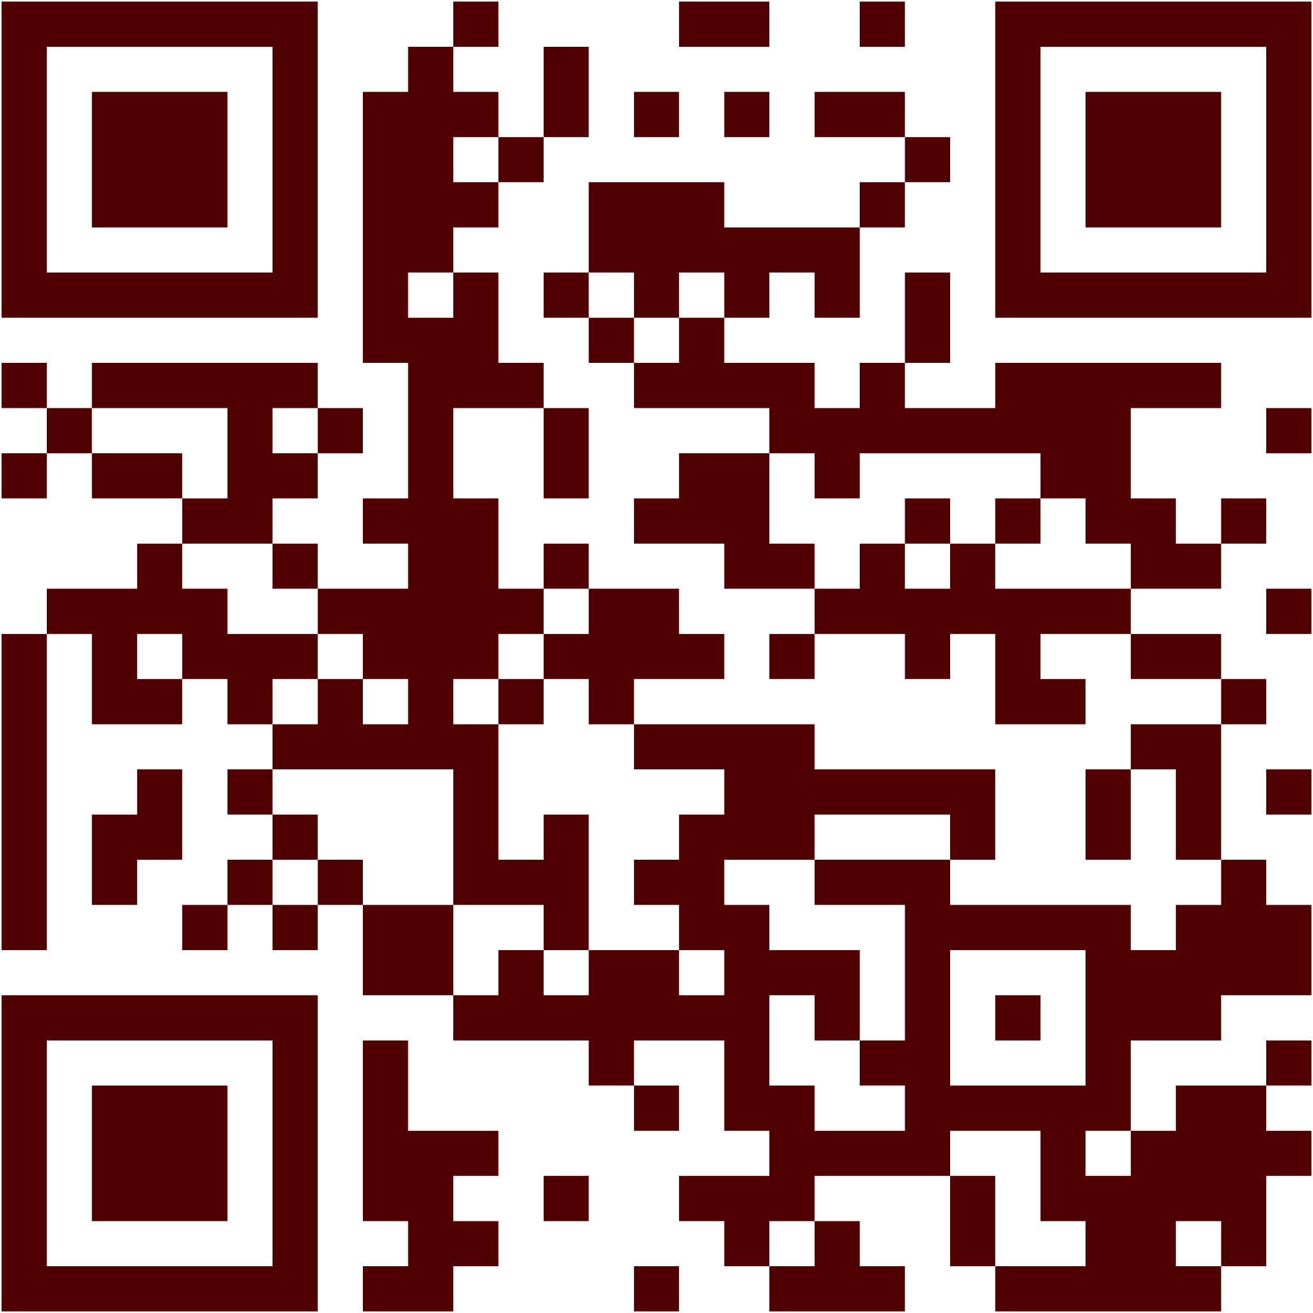






Sign in:
tx.ag/ACCFall24SignIn
Icebreaker:
What are you most excited for this semester?

Slide 2

🚀 Project Member Sign-Ups!
ACC presents:
Fall 2024
Notes:
Casey

Slide 3
Throwback to how the ACC Project System* Works
👇
Project Member Sign-up Deadline: 9/15 @ 11:59 pm
8/26
9/09
9/15
11/25
Projects are introduced and explained. Project Manager signups open.
Project Managers present their project ideas. Project member signups open.
Project members are assigned to projects.
Project Managers present the result of their projects to general meeting.
*patent still pending

Slide 4





HOW PRESENTATIONS WILL WORK
💡💡💡
Project Managers will give presentations on their project ideas:
gives overview, technology/languages, expectations, PM contact information, etc.
Once all Project Managers are done presenting, they will stay in the center to answer any questions.
The Project Member signup sheet will also be opened (via link and QR code) at the same time and you can begin signing up!
❓
📱
✅
Notes:
Harsh

Slide 5
Being a (Good) Project Member
each project will give its own expectations and instructions on how to be a good member, but in general you should:
be excited and willing to participate and learn
have a Discord and GitHub (so we can organize you into your project group)
reply/react promptly to messages and announcements from your PM
have >1-2 hours per week to set aside for your project work (likely more for certain RF projects)
SIDENOTE: you can signup for UP TO (1) RF and (1) LF project
To signup to be possibly selected to co-PM a project, you will also need to submit a resume with relevant experience :)
Notes:
Rain

Slide 6

ountability System
The ACCountability System is meant to reward active PMs and move members out of inactive projects:
Switch Project Request forms will open shortly after projects begin
Anonymous Project Manager Review forms
This system is meant to keep projects active and make sure members have fun!
Bad PM
Members: 0
Good PM
Members:
∞

Slide 7
OVERVIEW OF PROJECTS*
💡
LF Projects
LEARNING-FOCUSED (LF)
⌨️
Leet Camp
👍
Aggie-related
RESULT-FOCUSED (RF)
👾
Games
🤖
AI/ML
📱
Web/Mobile/Desktop Apps
⚙️
Hardware
*Very loosely organized within these categories
Notes:
AJ

Slide 8
LEARNING FOCUSED
Notes:
Harsh

Slide 9

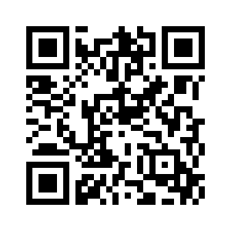
LeetCamp
⚙️
“The only way to learn code… is to write code” - Someone on the Internet
Learn algorithms and data structures starting from the ground up!
Data Structures & Algorithms
Python & C++
Leetcode Problems!
Resume Help (?)
PM Discords:
@umer_ (Umer Sajid) and @yessir8631 (Khanh Dao)
First meeting next TBD - watch discord
Join LeetCamp using the #role-select channel on Discord!
Notes:
can support 14-48 people. brady is so cool B) awww - brady

Slide 10




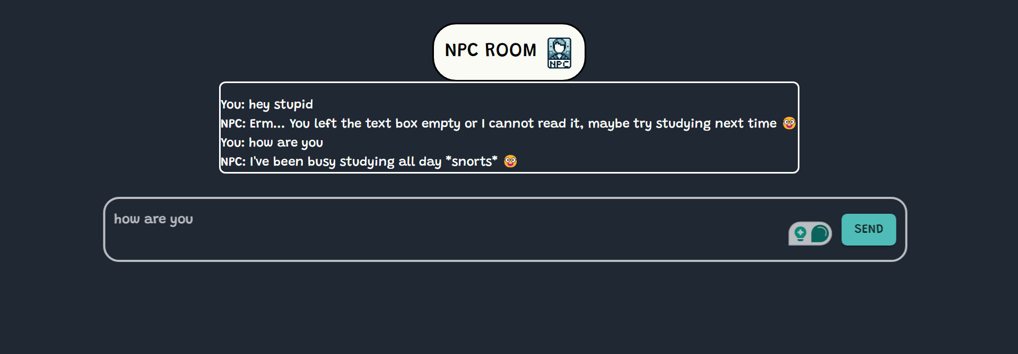
NPCRoom
⚙️
PMs: Obinna Nwakwue (obi_awesome), Adam Mackintosh (servitorxur)
Technology/Languages/Libraries
Front-end: React (MaterialUI)
Backend: Java/Spring Boot
Database: MongoDB
Skills you will learn
Full-stack web development
Effective deployment
Login/registration
Expectations
Prerequisites: Basic programming knowledge
Commitment: ~1 hr/week
Notes:
can support 14-48 people. brady is so cool B) awww - brady

Slide 11
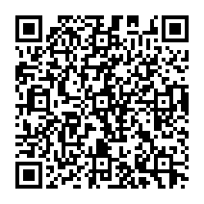
SQL
Nicole
MySQL
NOAA & CDC data
First project: download MySQL, Build a table, import data
Second Project: relational database, use data from first project
Can attend in person or via zoom

Slide 12







Circle K International WebDev
👍💡📱
PM
Declan Staunton (DECLOON)
Technology/Languages/Libraries
Front-end: HTML/CSS/JS
Back-end: Flask/Python/SQLAlchemy
Deployment: Defang
Skills you will learn
Full Stack Development
Data Management with SQL
Login/Authentication
Expectations
Basic Programming Experience
Time commitment
A good attitude :)
Additional Information
Commitment ~2 hr/week
Notes:
can support 14-48 people. brady is so cool B) awww - brady

Slide 13
RESULT FOCUSED

Slide 14

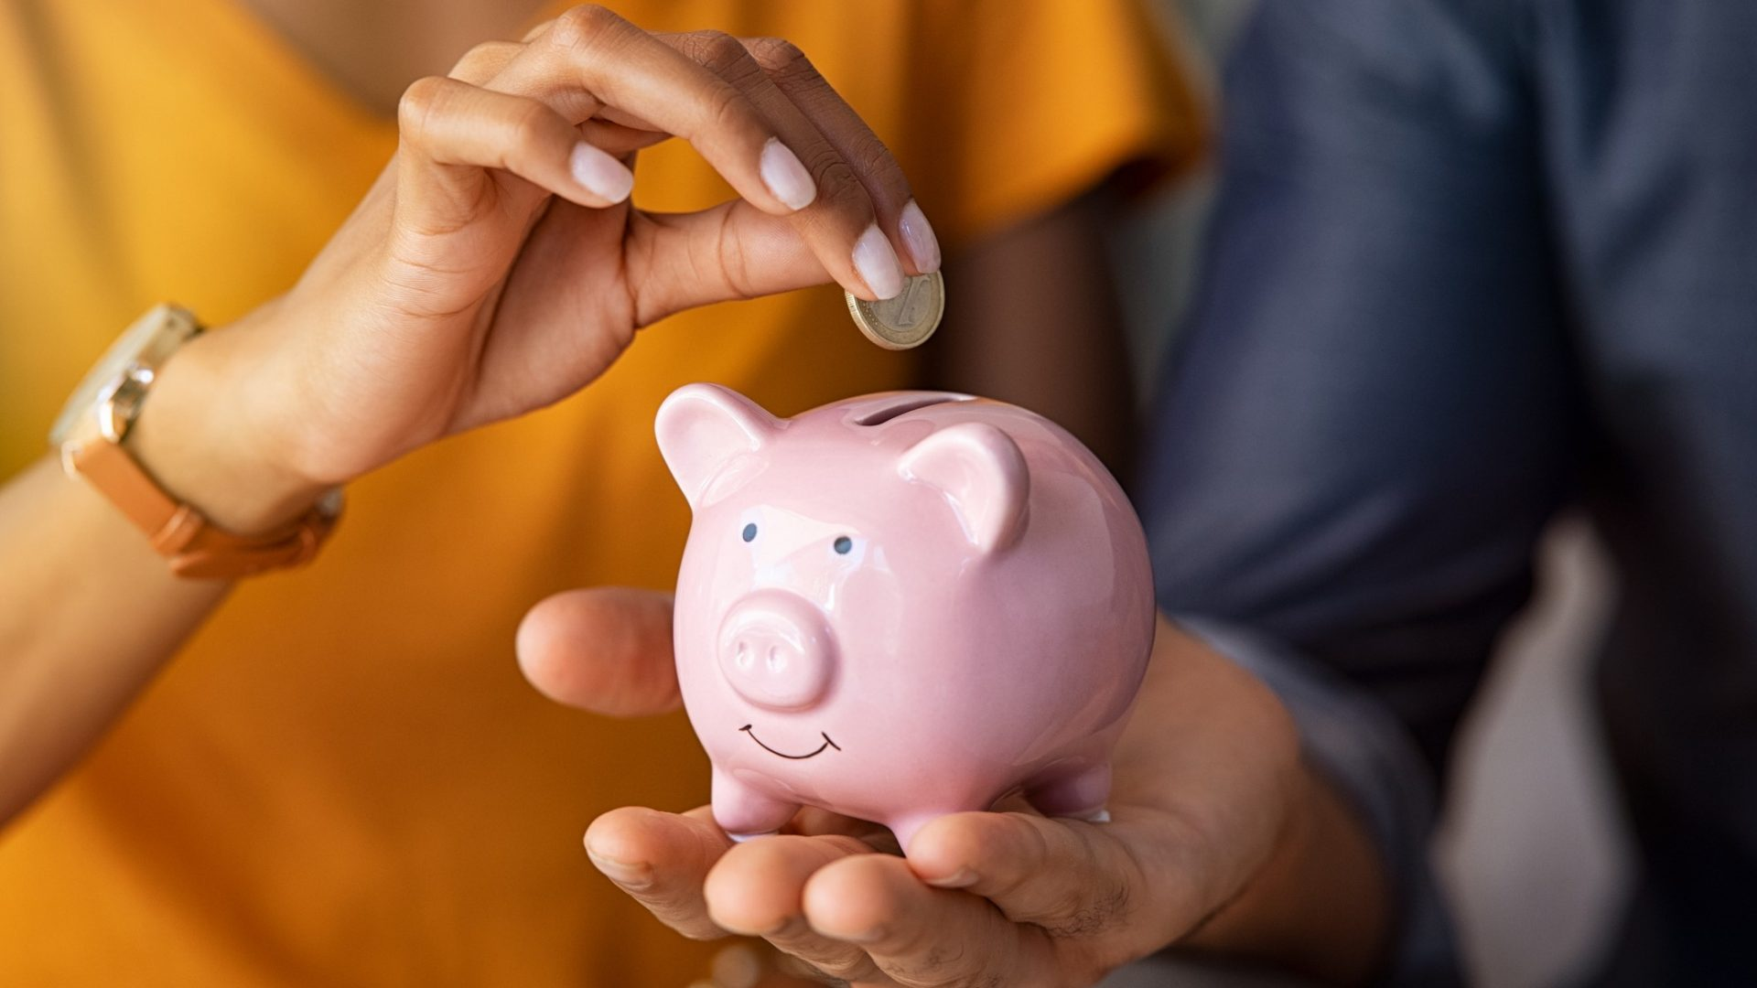






Townstore
Project Managers
Ibraheem Razouki (alhekma)
Zarek Khan(Zarek)
Technology / Languages / Libraries
React
Python
MongoDB
AWS
Skills you will learn
Full Stack Development
Database Management
Deployment & Authentication
Expectations
Able to attend weekly meetings
2 - 3 hrs / week
Persistent and love to learn!
Notes:
can support 14-48 people. brady is so cool B) awww - brady

Slide 15
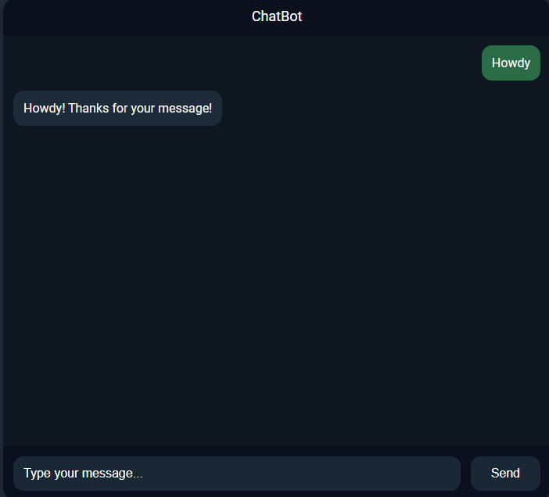
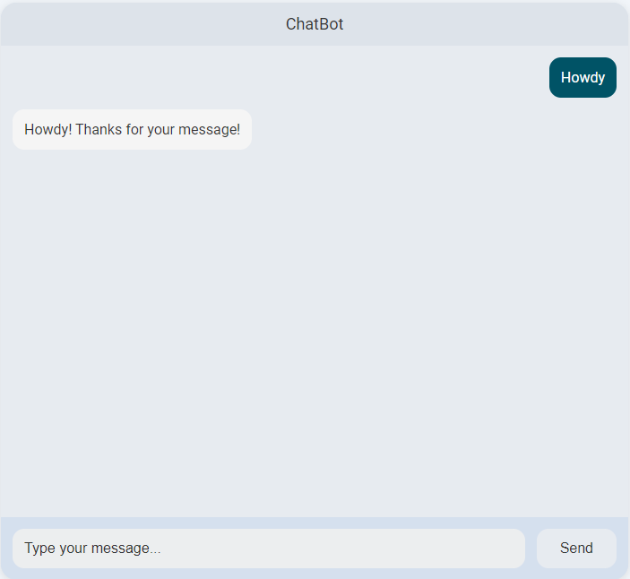
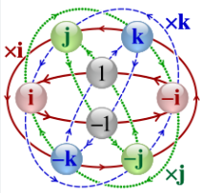


Neural Networks Parallel
⚙️
PM
Vijay Seetharam (Discord: TreiGott)
Ethan Van Swearingen (Discord: etvan)
Technology/Languages/Libraries
Python: integrating python libraries (i.e. pandas, tensorflow etc.)
C++: Pointers and mapping
Skills you will learn
Api integration
Mathematics: Hypercomplex
Enhanced Knowledge on LLMs
Expectations
Replace the API with that of Llama’s, and expand knowledge base.
Implementing interesting features such as a coordinate system and hypercomplex features (i.e. depth).
Additional Information
Initially built for the purpose of dispensing knowledge on university football
Notes:
can support 14-48 people. brady is so cool B) awww - brady

Slide 16



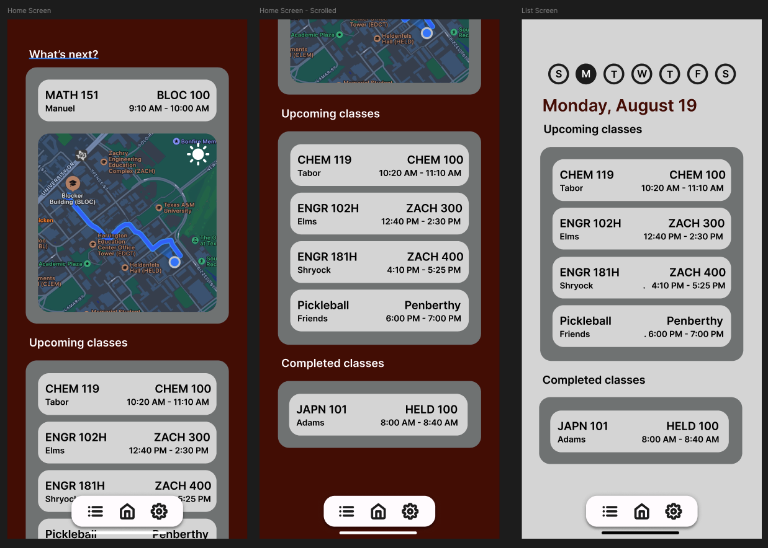
Aggie Agenda
⚙️
PM:
Mihir Mankikar (tsukiplayz)
Ethan OBrien (pie2793)
Technology/Languages/Libraries
React Native (Frontend)
JavaScript (Backend)
FIgma (Design)
Skills you will learn
UI/UX Design
App Development
Full-Stack Development
Expectations
Be ready to learn!
Meet a few hours / week
Additional Information
My goal is to complete the project by the end of the semester so we all gain some experience and have a resume booster.
Notes:
can support 14-48 people. brady is so cool B) awww - brady

Slide 17
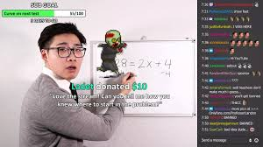
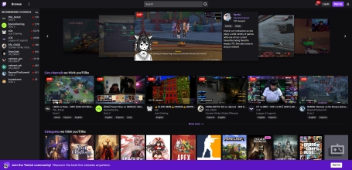


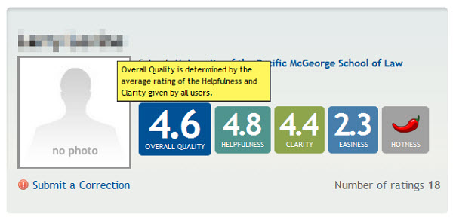
⚙️
Student Study Streams
PM: Nam Le (NTL5696)
CO-PM: Still looking, hopefully someone with decent programming experience
Technology/Languages/Libraries
Backend: Javascript/Python
Frontend: Javascript
Database: MongoDB or Django
Skills you will learn
Full Stack Development
Login/Authentication
Expectations
Collaborate and help each others out
Willing to learn
Make time for meetings (maybe like once a week on weekends)
Additional Information
It would be nice to have this project done by the end of the semester, but there is no set time. Also if you are a freshman like I am, please prioritize ETAM over this project, like I will
Notes:
can support 14-48 people. brady is so cool B) awww - brady

Slide 18
Switchless
⚙️
Notes:
can support 14-48 people. brady is so cool B) awww - brady

Slide 19
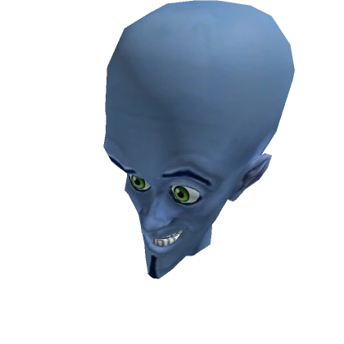


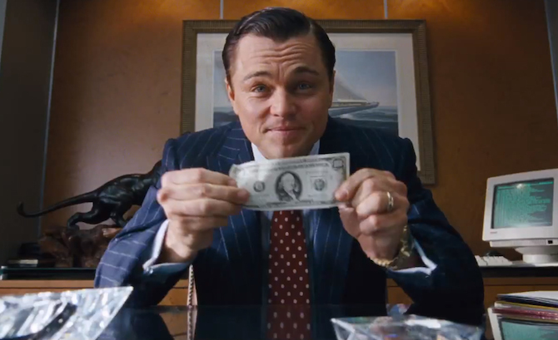
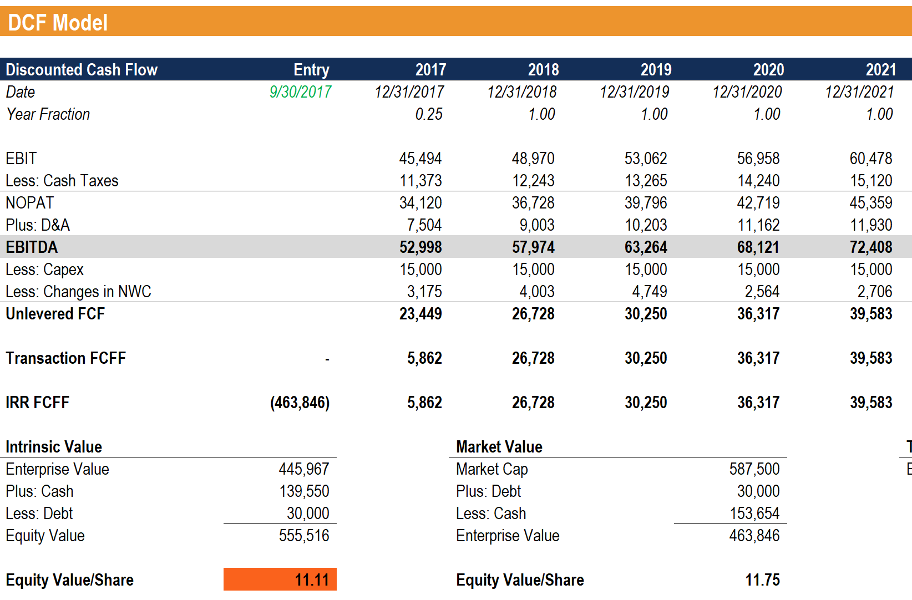
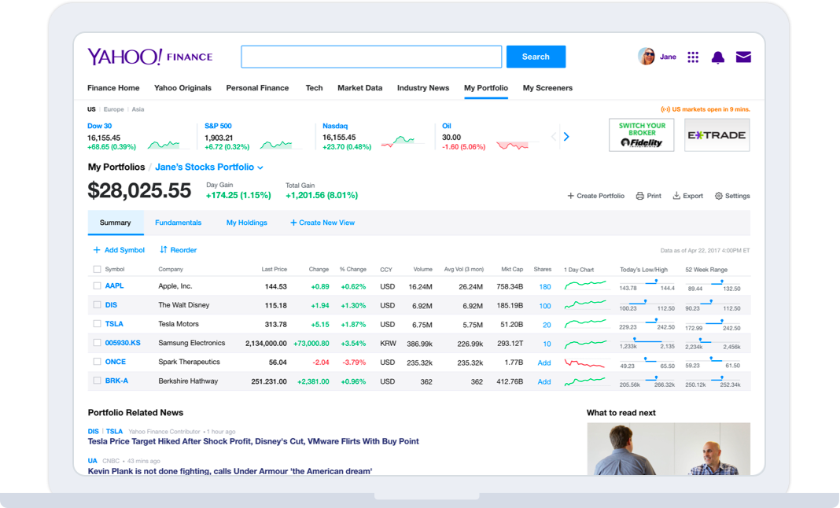
Prophetic Vision Stock Picker
⚙️
PM:
Yuriy Astapov (Kadez)
Leonardo Holloway (rwandanwarlord)
Technology/Languages/Libraries
C++
.NET (maybe?)
Skills you will learn
Basic data analysis, security analysis
Practical C++ experience
Expectations
1-2 hours per week
Basic programming experience (C++ preferred)
Basic understanding of statistical concepts
Additional Information
Pretty cool looking for resume
Basic UI implementation if time allows
(perhaps)
Notes:
can support 14-48 people. brady is so cool B) awww - brady

Slide 20

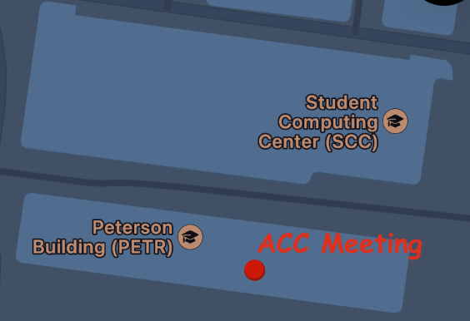


Occasion
⚙️
PM
Shayla Jha (onomatopoeia_was_taken)
Tejas Chitrager (xtremetoast)
Luke Abraham
Ryan H.
Technology/Languages/Libraries
Swift
SQL
Apple maps and calendar API implementation
Skills you will learn
Agile product development
Expectations
Work hard, play hard
1-2 hrs per week
Features
An interactive map showing events happening in the area; ex: club meetings, career activities, parties, etc.
Centralized event directory
Subscription service to boost profile
Notes:
can support 14-48 people. brady is so cool B) awww - brady

Slide 21

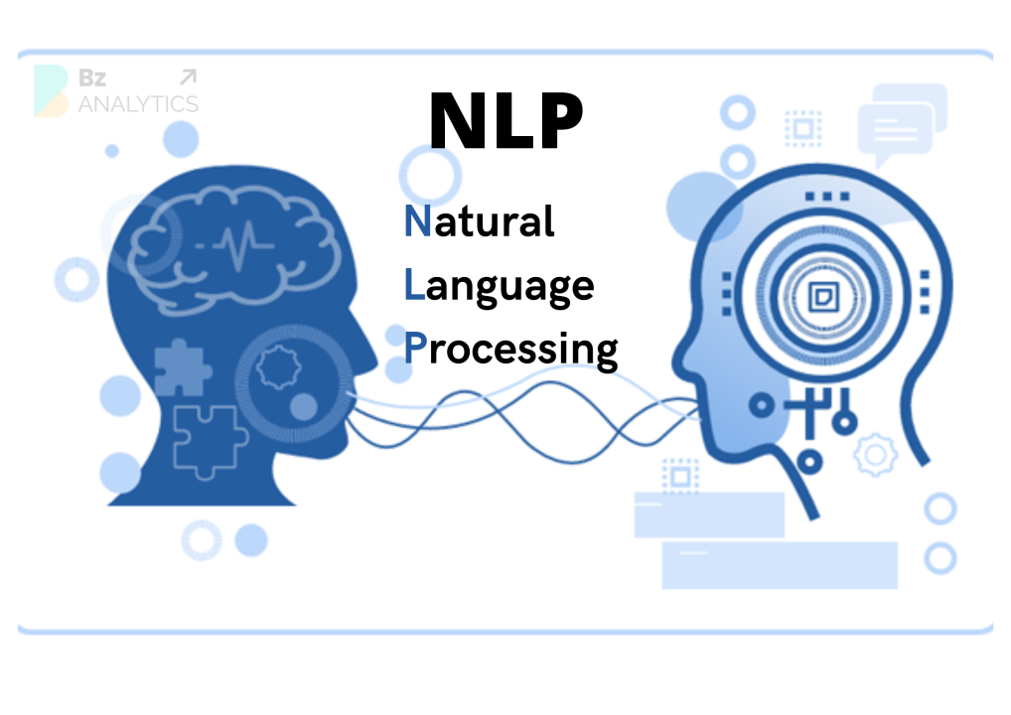
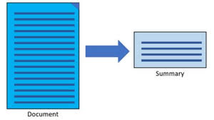
Readify
⚙️
PM:
Oluwadayo Bamgbelu (Dayo !)
Uday Chaudhary (Tamulover)
Technology/Languages/Libraries
Python for backend
Flask
Javascript
NLP Library - SpaCY or Transformer
Skills you will learn
Chrome extension development
Web scraping
Natural Language Processing
API Development
Expectations
Handling different webpage content
Designing a well structured UI
Insight into how language models process and generate text
Additional Information
:)
Notes:
can support 14-48 people. brady is so cool B) awww - brady

Slide 22
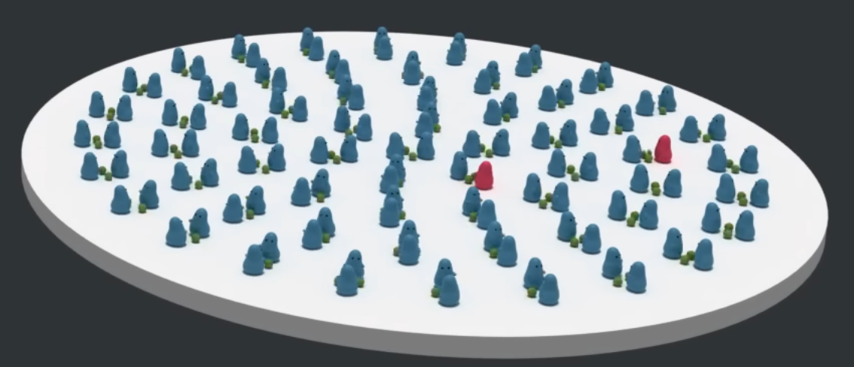

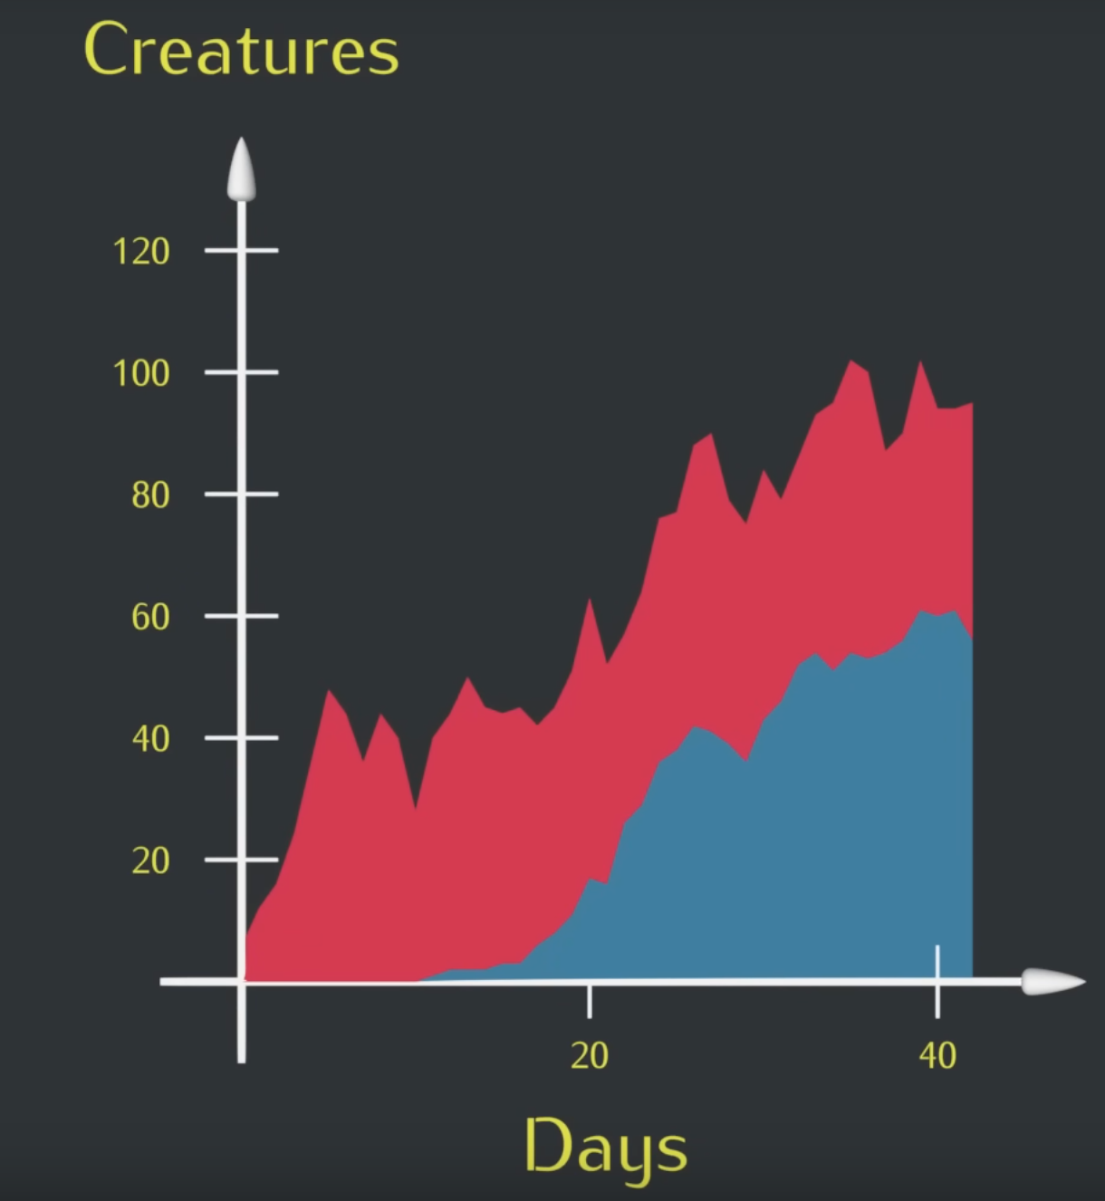

Evolution Simulation
⚙️
PM
JP Roque (jproque123)
Technology/Languages/Libraries
C++
OpenGL
Gnuplot
Skills you will learn
Scientific Simulation
Data Analysis
Data Visualization
Game Theory
Expectations
Basic programming skills
Additional Information
Weekly meeting, 1-2 hrs
Notes:
can support 14-48 people. brady is so cool B) awww - brady

Slide 23
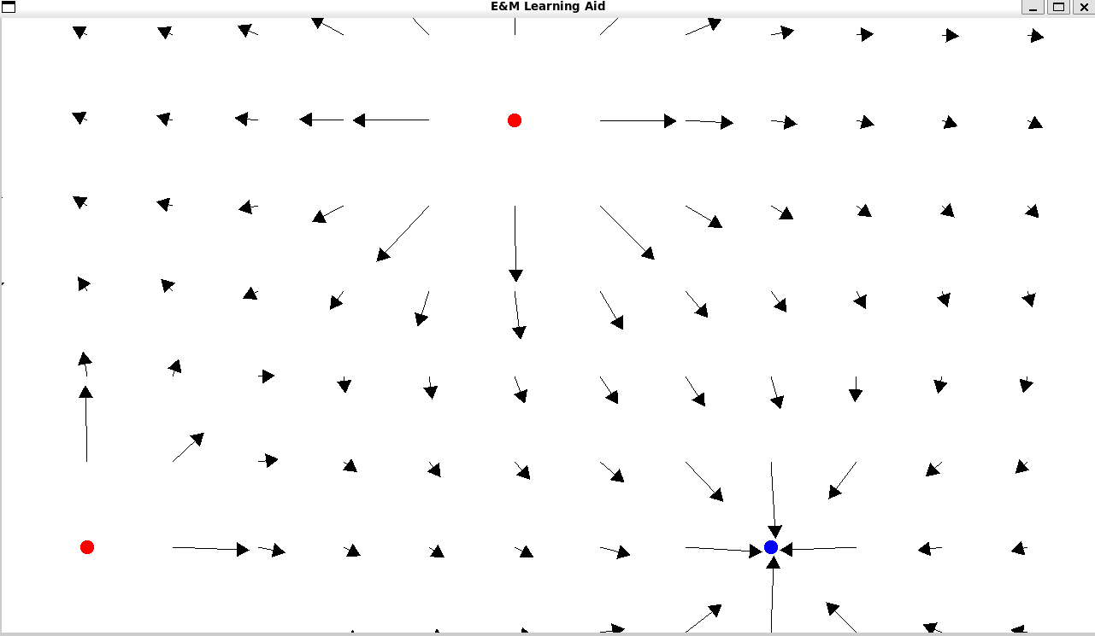


E&M Learning Aid
⚙️
PM
Sai Sudarshan Barath (nonamer)
Sanjit Mukesh (thafakeasian)
Technology/Languages/Libraries
C++
SFML (no experience needed)
Git
Skills you will learn
Working on software in a team environment
Reinforce your knowledge of physics
Expectations
C++, Basic Git experience (must have)
Some familiarity with E&M concepts
2-3 hours per week
Notes:
can support 14-48 people. brady is so cool B) awww - brady

Slide 24





FANTASY ESPORTS
⚙️
PMs
Sam Bush (SamShrubo)
Cesar Magana (zek8906)
Technology/Languages/Libraries
Python | JavaScript
React | FastAPI | Uvicorn
Some skills you will learn
🌐 Build REST APIs
🕸️ Web Scraping Basics
🎨 Web Design with React
💻 Backend Development, Frontend Design, Data Handling, and More!
Expectations
🧠 Proficient in Python & Javascript
⏰ Able to dedicate 1-2 Hours per week
🕹Interested in Esports :D
Additional Information
Reach Goals:
Integrate ML-Powered Predictions
Notes:
can support 14-48 people. brady is so cool B) awww - brady

Slide 25
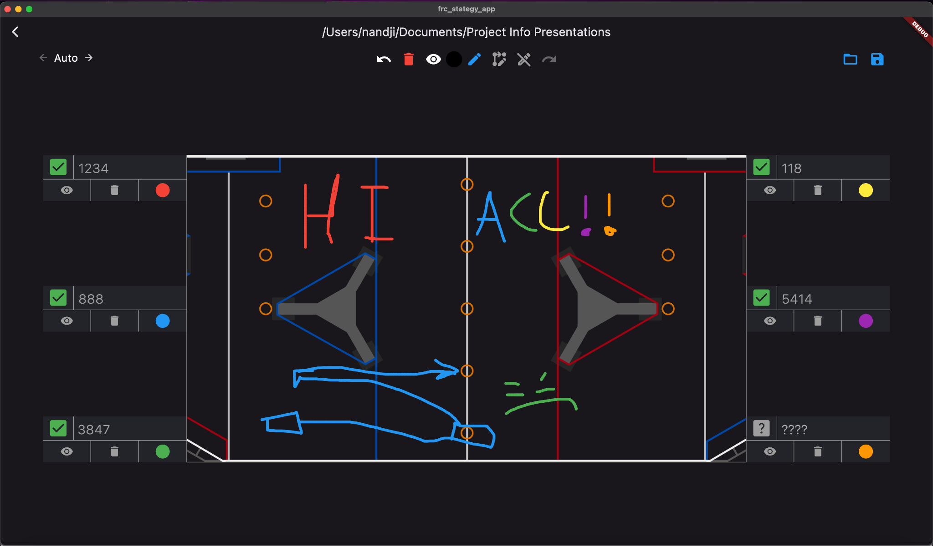

FRC Strategy App
PM
Jonathan Daniel (nandji)
What is this?
Fancy Whiteboard
For mobile/desktop/web
Technology/Languages/Libraries
Flutter
Firebase (maybe)
Skills you will learn
App development
Multiplatform compatibility
Open API use
Git
Expectations
Loose deadlines
Some familiarity with similar languages/frameworks
ish
Additional Information
App Demo
DM me!
⚙️

Slide 26
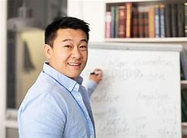

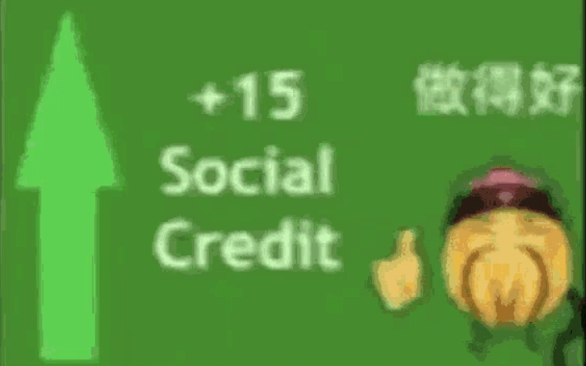
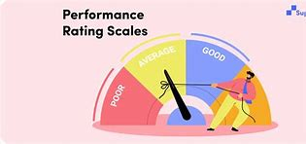
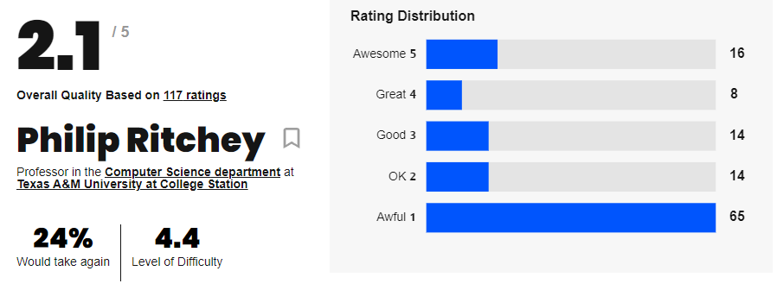
Rate My Tutor
⚙️
PM
Kevin Chen (Prunuus)
Licheng Yi (Krizim)
Long Vo (imaleagueaddict)
Technology/Languages/Libraries
JavaScript
React.Js/Next.Js
Backend - open to suggestions
Possibly MERN stack (?)
Expectations
Basic familiarity with the above list, cool, able to openly communicate thoughts, worries, etc. We want a close knitted group!
Additional Information
One meeting per week and some work agendas outside of meetings
Optional: league nights
Notes:
can support 14-48 people. brady is so cool B) awww - brady

Slide 27
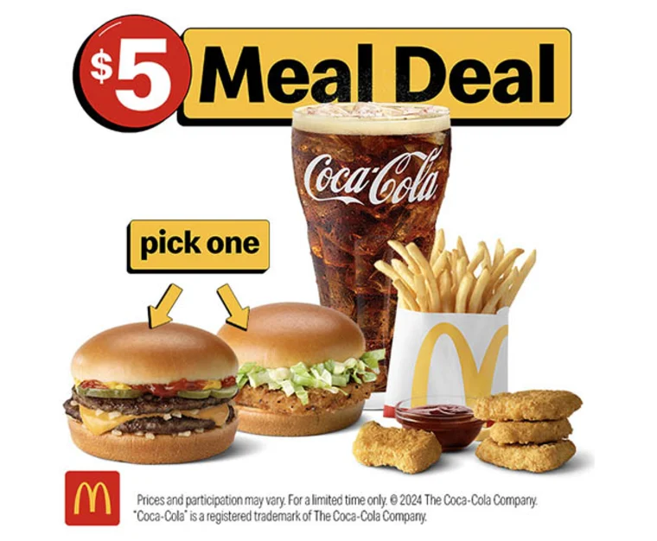

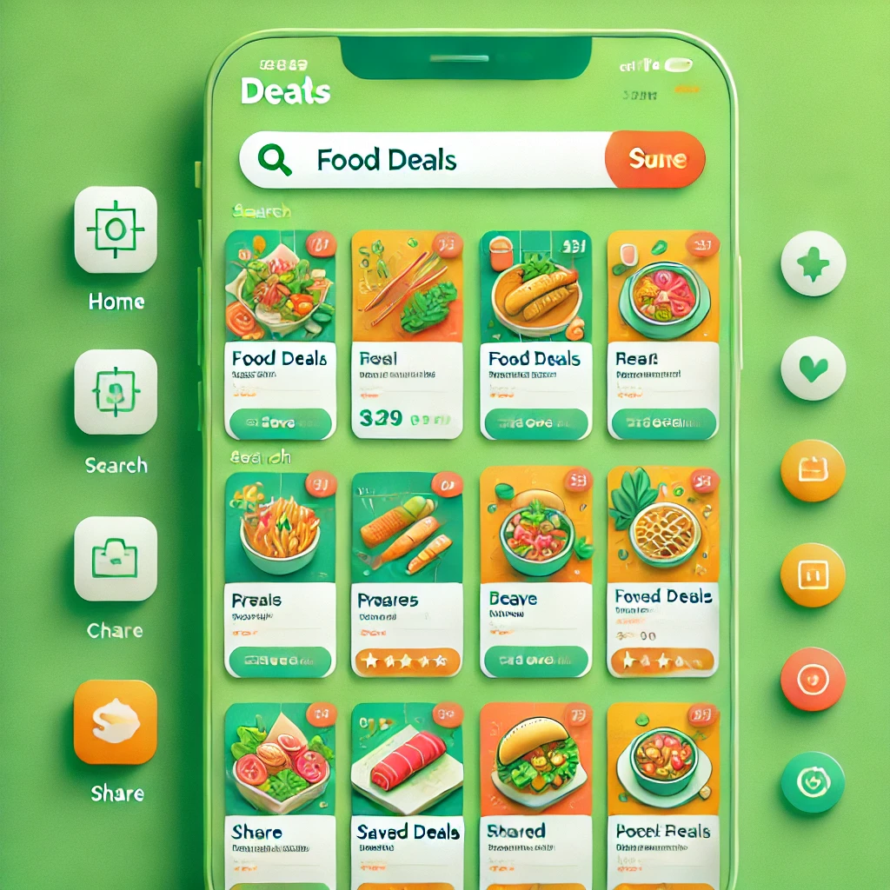
Food Deal Website
⚙️
PM
Akul Ranjan (Akul R.)
Rohan Shanbhag
Technology/Languages/Libraries
Firebase
Flutter
Git
Python
Skills you will learn
App dev
Database management
Backend with Python
Expectations
Please be willing to learn and adapt to new technologies and taks.
Additional Information
Small group focused, will be a causal time commitment.
Notes:
can support 14-48 people. brady is so cool B) awww - brady

Slide 28
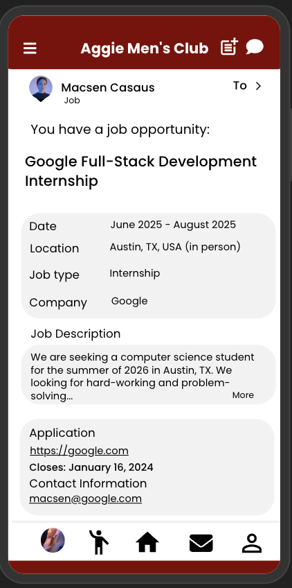
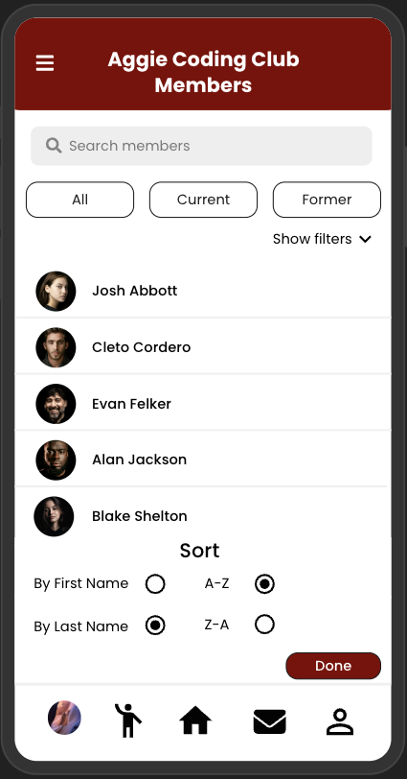
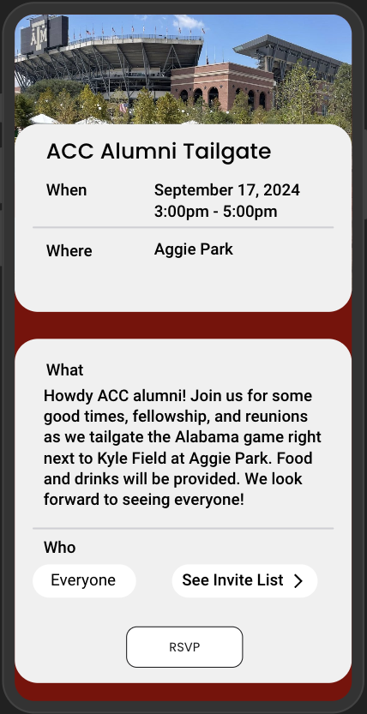
Former
PM
Cole Harris (cole2910
Macsen Casaus (rubixg))
Description
Mobile app that connects organization alumni to current members and other alumni
Allows orgs to formalize their alumni networks
Technology/Languages/Libraries
React Native (TSX)
Express.js (javascript)
PostgreSQL
Skills you will learn
Mobile Application Development
REST API design
Expectations
2-3 hours / week
React Native Frontend and/or node backend experience
Desire to get after it and build something awesome!
Notes:
can support 14-48 people. brady is so cool B) awww - brady

Slide 29
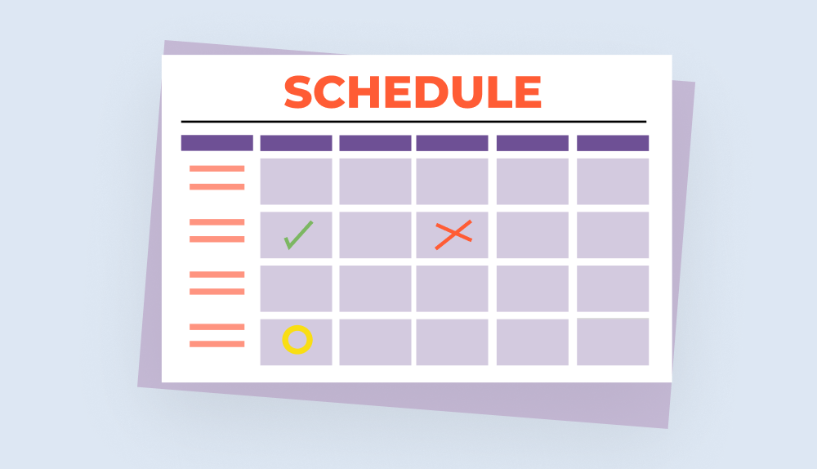
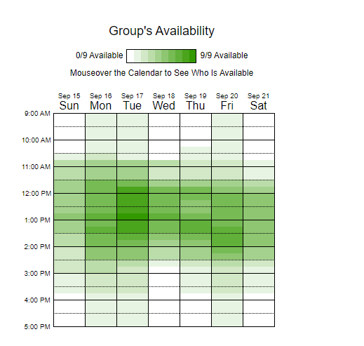
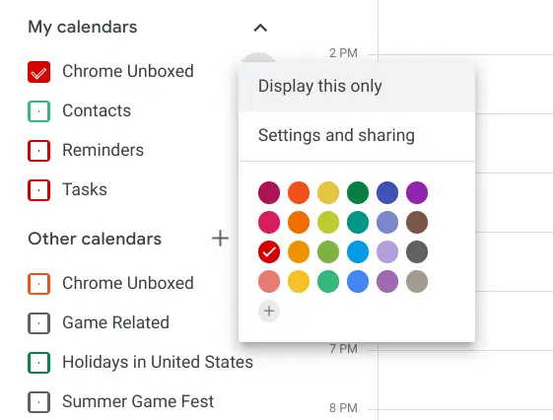



GroupMeet
⚙️
PM
Priyadarsi Mishra (stephaplash)
Daniel Trinh (Smoothiekanoble)
Technology/Languages/Libraries
Spring Boot (backend)
GraphQL (querying service)
PostgreSQL
React.js (frontend)
Skills you will learn
Full-Stack Web Development
Expectations
2-3 hrs/week
Basic Version Control (Git)
Some familiarity with above languages
Additional Information
Create a when2meet inspired website importing “commitments” from Google Calendar, Notion, other APIs, except “commitments” are censored like how it is in when2meet. Each user can create their profile(s) and share with others through links or QR codes. Users’ dashboard displays calendar and provides “friend’s” togglable calendars, optionally including location. The purpose of this is to be able to decide on weekly meeting times based on everyone's availability, while not requiring the user to recreate their calendar for every single event. Contact us with any questions!
Notes:
can support 14-48 people. brady is so cool B) awww - brady

Slide 30




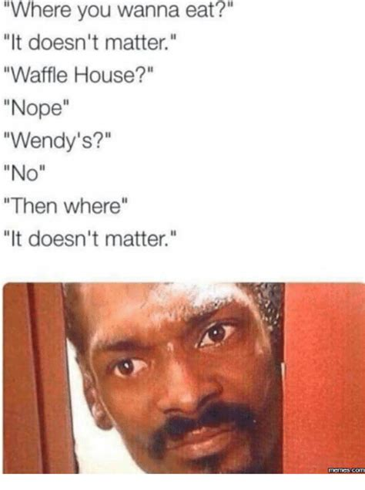
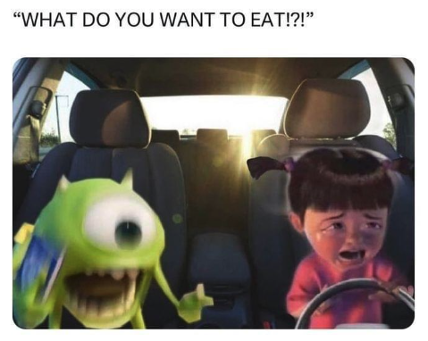
Sizzler
⚙️
PM
Andrew Mao (chicken.biryani)
Art Young (atsubyo)
Technology/Languages/Libraries
Frontend:
Javascript/Typescript
React Native
Backend:
Express & Node.js
MongoDB
Skills you will learn
Full Stack Mobile App Development
Working with various APIs
Google Maps, Yelp
Expectations
Weekly Meetings (time and day TBD)
Preferred Javascript experience but none needed. (We’ll teach you!)
Eager to learn and build something!
X
=
Tinder BUT for restaurants
Notes:
can support 14-48 people. brady is so cool B) awww - brady

Slide 31
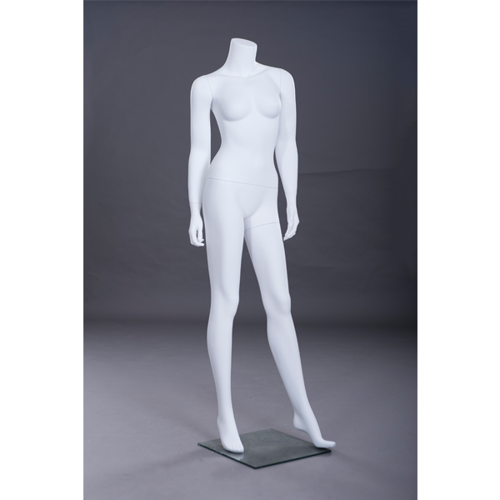
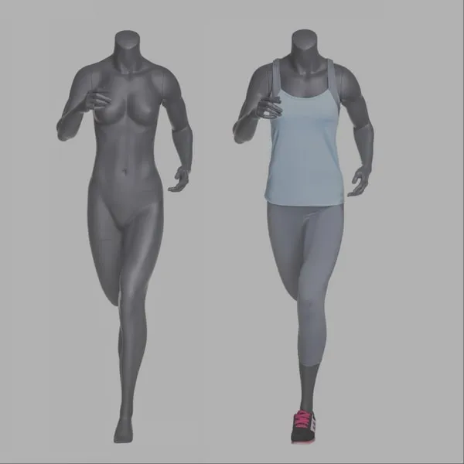


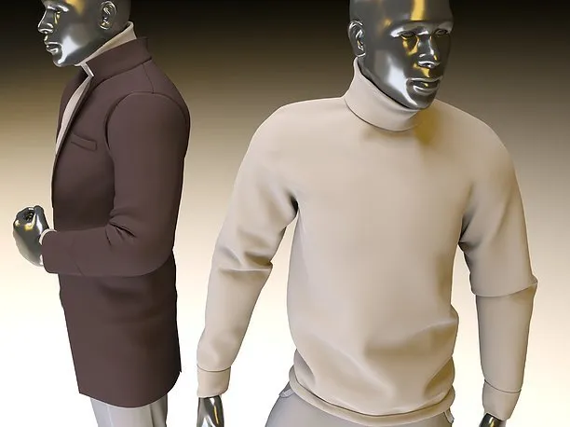

Mannequin
🤖📱
PM
Dylan Myers (Eskimose)
Walker Campbell (RejectPolarBear)
Technology/Languages/Libraries
C++ (3D modeling)
Web/App development
Python (PyTorch)
Skills you will learn
Machine Learning
3D modeling
App development
Expectations
Familiarity with one of the previous technologies (C++, Python, PyTorch)
2-3 hours a week, weekly meetings
Additional Information
Contact us with any questions!

Slide 32

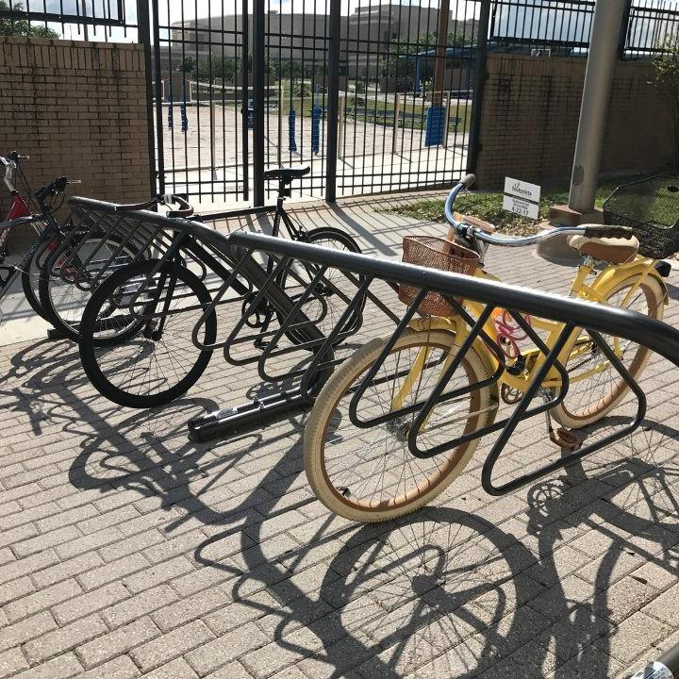
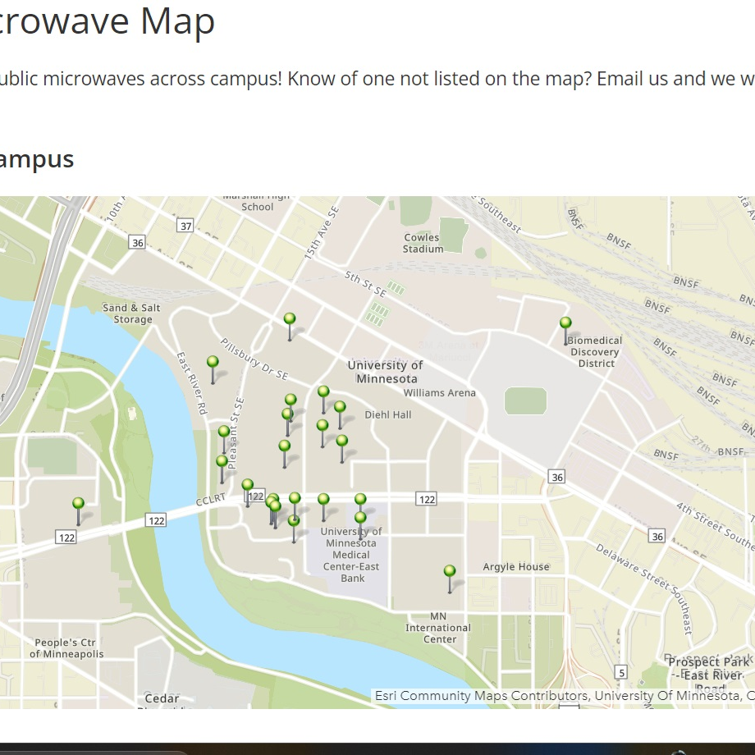
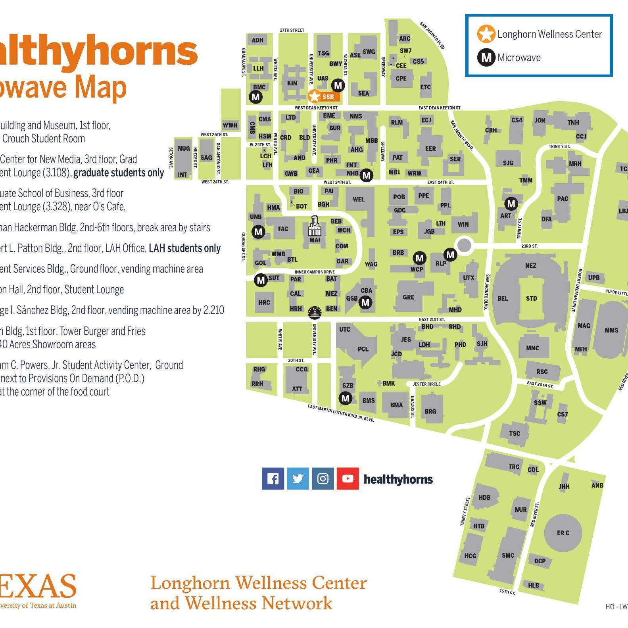
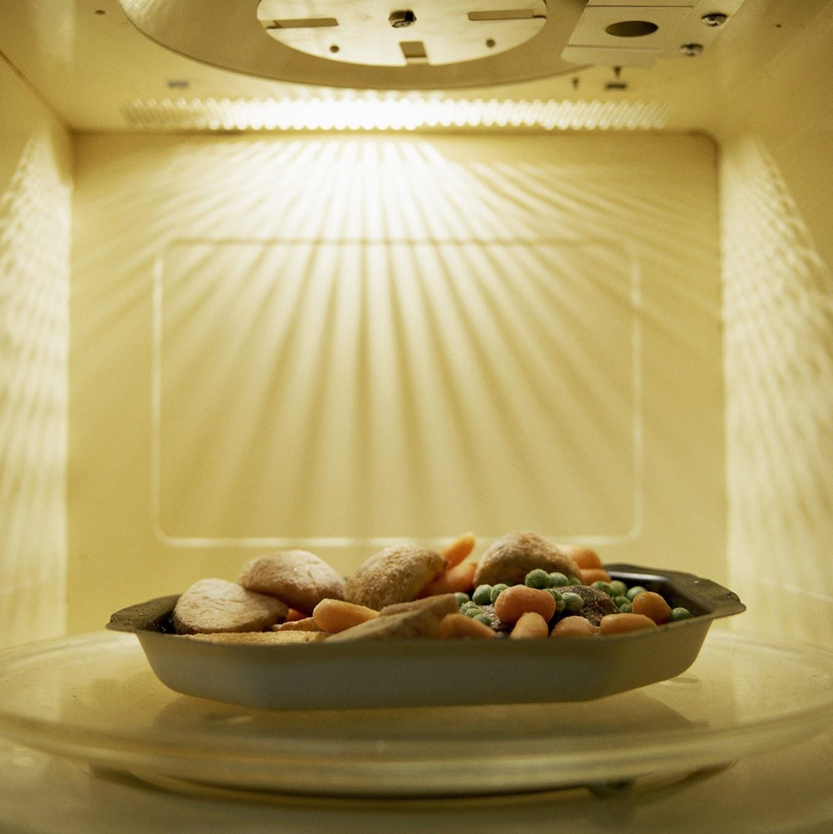
FindIt A&M
⚙️
PM
Lance Kakkassery (lance3950)
Christian Paul (the.christian.paul)
Technology/Languages/Libraries
Django
Google Maps API
CSS/html
Bootstrap
Skills you will learn
Full Stack development
Project Workflow (Agile)
Website Deployment
Expectations
No Experience Needed!
1-2 Hours a Week
Additional Information
Open to all
Skills are new to (mostly) everybody
Notes:
can support 14-48 people. brady is so cool B) awww - brady

Slide 33
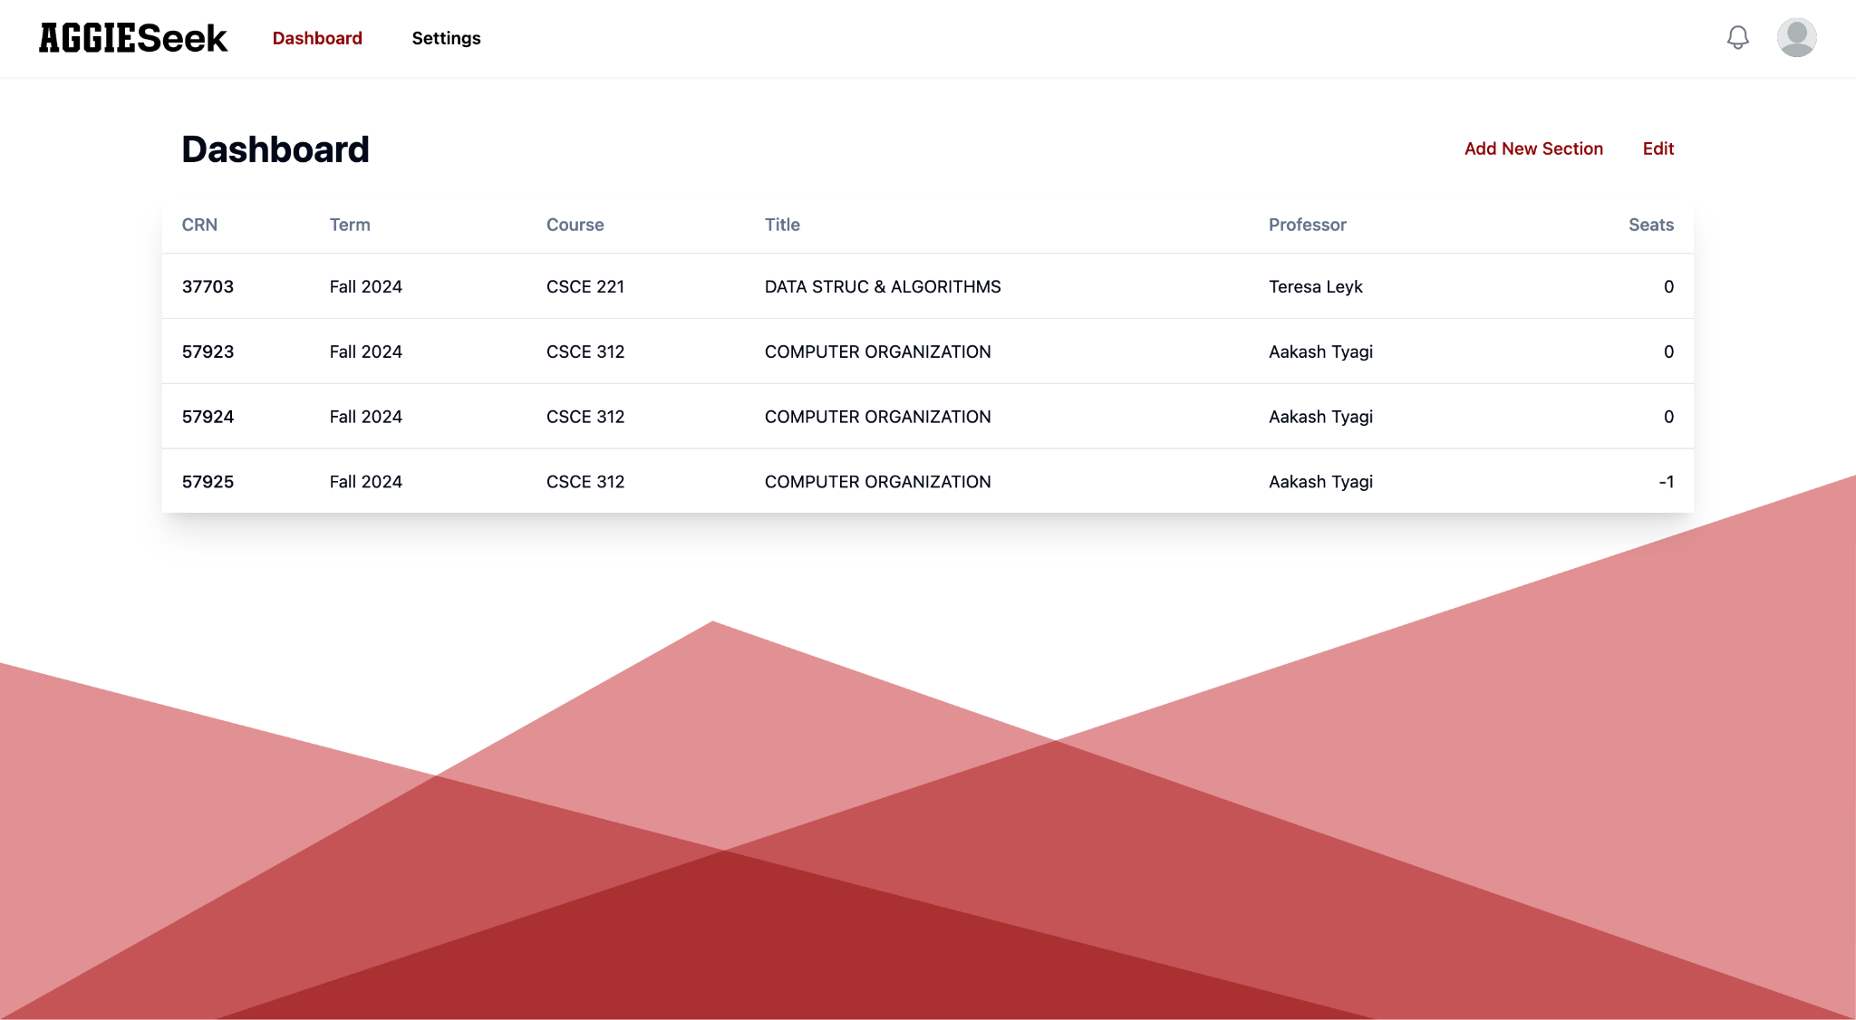

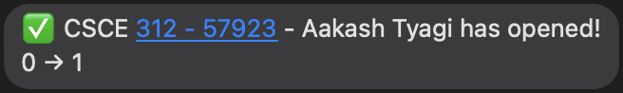
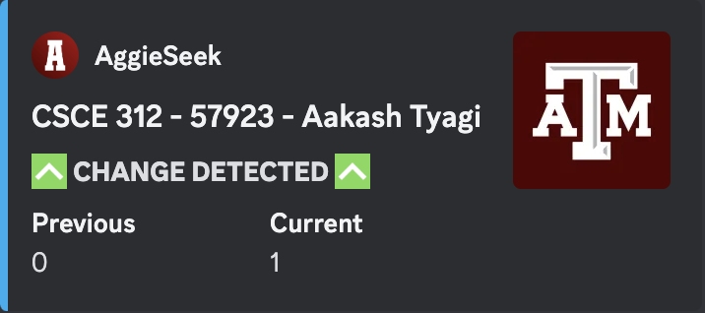


⚙️
Project Managers
Peter Phan koipandaa
Daniel Zhang kanpeki_
Sophia Phu sophieemagi
Technology / Languages / Libraries
React, React Native
Python, Flask
Firebase
Skills you will learn
Full Stack Web Development
Cross Platform Development
Web Scraping
Expectations
Able to attend weekly meetings
1 - 2 hrs / week
Strong commitment to learning!
Notes:
can support 14-48 people. brady is so cool B) awww - brady

Slide 34






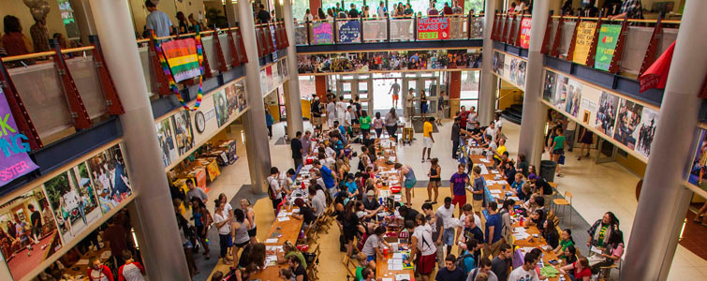
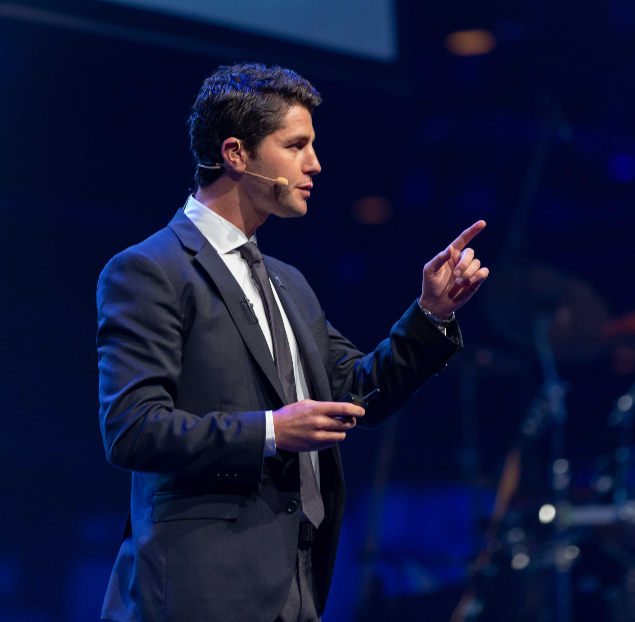
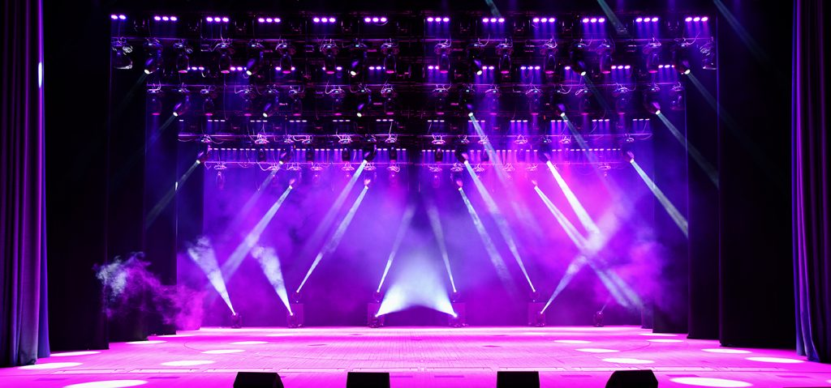



AggieEvents
👍📱
Project Managers:
Alexander Bui (Constid)
Jadon Lee (jadotomato)
Crowd-sourced event database and calendar where anyone can contribute and search for events and organizations happening around Texas A&M campus.
Relevant Technology
Nextjs, Tailwind, Typescript, Postgresql, Docker
Skills you will learn
Full-stack web development
Expectations
Keep up with Discord or other communication
Show up to weekly meetings (time and location TBD) and spend 2-3 hours weekly working on project
Enjoy what you are doing!!
Additional Information
Contact any one of us on discord if you have any questions

Slide 35









Ready Routes
⚙️
PMs
Gabe Toro (.DGB_)
Arnav Gangur (.arnav_g)
Technology/Languages/Libraries
Javascript
CSS
HTML
Google Cloud Platform
Maps API
Expectations
Knowledge in DS&A
Experience with JS backend or experience with HTML/CSS frontend
Weekly meetings and 1-2 hours per week of work outside of meetings
Notes:
can support 14-48 people. brady is so cool B) awww - brady

Slide 36





AggieStudy
⚙️
PMS
Cam Stone (evilspoon13)
Brayden Bailey (Brayden.bailey)
Technology/Languages/Libraries
Frontend: JavaScript (React.js)
Backend: SpringBoot (Java)
Database: PostgreSQL
Skills you will learn
Full-Stack Web Development
Expectations
1-2hrs/week
Additional Information:
AggieStudy is a one-stop website for Aggies to study for their exams! From previous year exams to study materials from each professor, we are aiming to make an interactive and easy to use website to study for any course at Texas A&M. This project is solely for fun and we welcome any experience level! Check out the github to see progress that has already been made: https://github.com/kcplAgs/AggieStudy
Notes:
can support 14-48 people. brady is so cool B) awww - brady

Slide 37







Starting from the STEM
⚙️
PM: Justin Garrity (scb)
CO-PM: Looking For One
Starting from the STEM is a full stack web application designed to teach STEM from a ground up approach.This app embeds good study techniques and AI directly into the course material.
Technology/Languages/Libraries
Next.js Typescript, PostgreSQL, Strapi, Framer Motion, OpenAI API
Skills you will learn
Full Stack Web Dev
Web AI integration
Web Animation/UI
Expectations
Passion to Learn
2hr per week commitment
Notes:
can support 14-48 people. brady is so cool B) awww - brady

Slide 38





Survivor Sports League
⚙️
PM
Jason Garcia (JsirG)
Eduardo Enriquez (AirplaneCakes)
Looking for one more!
Technology/Languages/Libraries
C++, HTML, JavaScript
GitHub, Figma, React
Node.js, MongoDB, Sportradar API
Skills you will learn
Full-stack web development
How to win your fantasy football league ;)
Expectations
1-3 hours per week
Additional Information
Survivor Sports League is a fantasy-sports like app but intended for the more casual audience. We are starting from scratch this semester, so there will be a lot of learning but we hope to have lots of fun with this project!
Notes:
can support 14-48 people. brady is so cool B) awww - brady

Slide 39

SyllabiSurplus
⚙️
PM: Ayo Aina (_ayoaina26)
Co-PM: TBD
Technology/Languages/Libraries
HTML/CSS
JS
React
Skills you will learn
Time management
Full-stack web development
Research
Expectations
1-2 hrs per week
Familiarity with web development.
Additional Information
Contact us with any questions!
aaina26@tamu.edu
SyllabiSurplus is a full stack web application designed to serve as a repository for all Aggie classes and their syllabus. The hope is to fully deploy this for functional purposes in the student body. Come be part of something that will benefit all Aggies!
Notes:
can support 14-48 people. brady is so cool B) awww - brady

Slide 40




Seamless Neural AI Capture
📸🐍
PM
Michael Fritzer (Mike97)
Christion Bradley (xproioxis)
Technology/Languages/Libraries
Python
Computer Vision
Microcomputers
Camera Tech
Machine Learning
Skills you will learn
Front-End
Web Scraping
Segmentation
Expectations
Commit at least an hour a week
Be willing to work
Additional Information
Hardware experience appreciated
Can be abbreviated as SnAIc [pronounced ‘Snayk’]
[Hardware subject to change]

Slide 41





Rust GBA Emulator (FeGBA)
⚙️
PM
Nitish Malluru (buface)
Aiden Beresford (throggie)
Technology/Languages/Libraries
Rust
WGPU
Skills you will learn
Computer Architecture
Memory Management
Expectations
Familiarity with C++, C, Rust, or any language where you manually deal with memory
Additional Information
Hopefully 2-3 Hours a week time commitment
Notes:
can support 14-48 people. brady is so cool B) awww - brady

Slide 42



Wok Hei
⚙️
Web app that lets users plan their next meals with their current ingredients, and to help plan out groceries.
PM
Harrison Ko (happinessnoises)
Julian Hon (jujeu)
Technology/Languages/Libraries
Frontend- ReactJS, NextJS, Figma, Vercel
Backend- Clerk, MongoDB, OpenAI
Skills you will learn
Git flow
API Calls
User authentication
Expectations
Experience with frontend
Additional Information
Meetings once a week 1 hour
Individual labor 2 hours a week
Notes:
can support 14-48 people. brady is so cool B) awww - brady

Slide 43




Break up a Baddie
⚙️
PM
Dylan Hoang
Fady Seha
Kyle Moore
Technology/Languages/Libraries
Pygame
Python
TensorFlow
Skills you will learn
Game Development
API
Expectations
Show up to meetings
1-2 hours a week commitment
Additional Information
Notes:
can support 14-48 people. brady is so cool B) awww - brady

Slide 44





Spotify Playlist Map
⚙️
PM
Andre Athari (athariandre)
Brandon Yuan (fwakes)
Technology/Languages/Libraries
React
Python
SQL
Skills you will learn
Creating a full-stack app
Expectations
Experience in either front-end or back-end (doesn’t have to be React/Python/SQL)
Desire to learn new things
Additional Information
Commitment: 2 hrs per week (1 hour meeting, 1 hour outside of meeting)
Notes:
can support 14-48 people. brady is so cool B) awww - brady

Slide 45



TBDEngine (name subject to change)
⚙️
PM
Ilter Ulutas (fanfania333)
Looking for Co-PM
Technology/Languages/Libraries
Rendering: Vulkan, GLFW
Core Functionality: ImGUI
Scripting: AngelScript
Language: C++
Skills you will learn
Game Engine Design
Computer Graphics/Rendering
UI/UX Design
3D Physics
Expectations
Familiarity with a C-like programming language (C, C++, C#, Java, Swift etc.)
Ability to read documentation
Additional Information
Commitment ~2-3 hr/week
Notes:
can support 14-48 people. brady is so cool B) awww - brady

Slide 46

How to Enter Your Discord
We use an automatic sorting system that uses the Discord unique tag provided by applicants. Therefore whatever Discord unique tag information you enter must be EXACTLY correct.
Username (Don’t Use!)
Unique Tag (Use this!)
Let's say this is your discord…
INVALID Discord Name Format:
my discord is xproioxis
Xproioxis
Proioxis
xproioxis (Chris is so cute)
VALID Discord Name Format:
xproioxis
xproioxis
xproioxis
xproioxis

Slide 47



NOW:
> Q&A on anything projects related!
> Fill out the form to signup!
🚀
SCAN or TYPE:
tx.ag/ProjectSignUpsFall24
tx.ag/switchless
(Due Wednesday 11:59pm)
Notes:
PM 101

